Slide 1
Acturis - FullCircl

Slide 2
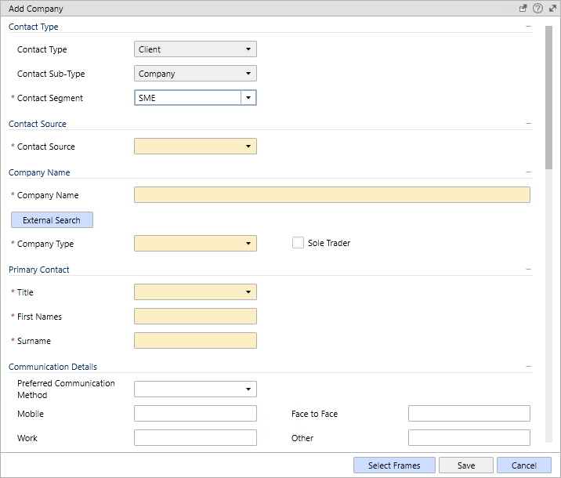
Add Contact
External Search Button
The Add Company screen will be updated to include a new External Search button
Note: All changes subject to the functionality being enabled for a particular organisation

Slide 3
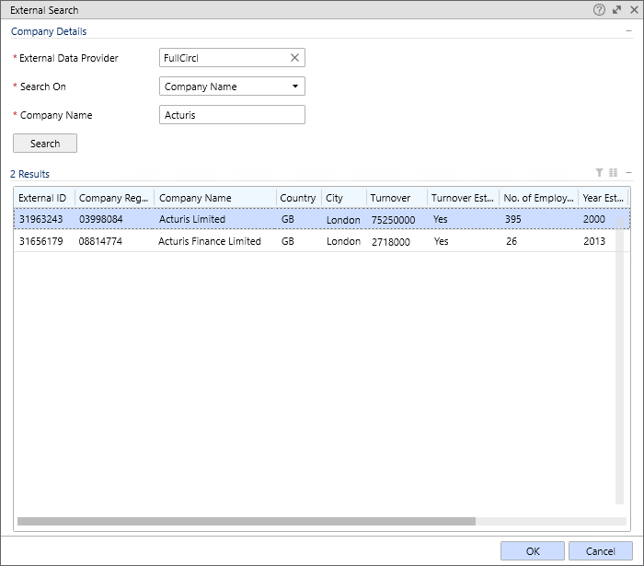
Add Contact
External Search Pop-Up
Pop-up when pressing External Search
Options to Search on Company Name, Company Registration No. or External ID
User to select correct result from the list

Slide 4
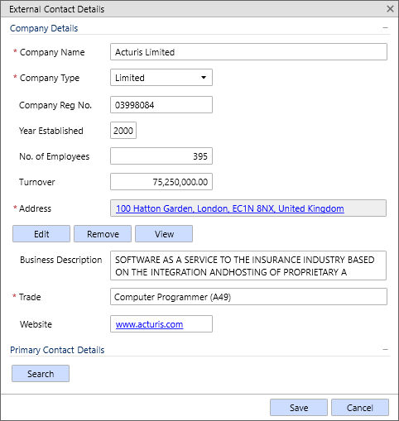
Add Contact
External Contact Details Pop-Up
Once a selection is made the External Contact Details pop-up is launched
This shows all of the Acturis system fields populated with data from FullCircl
A Search button allows selection of a “Primary Contact Person”

Slide 5
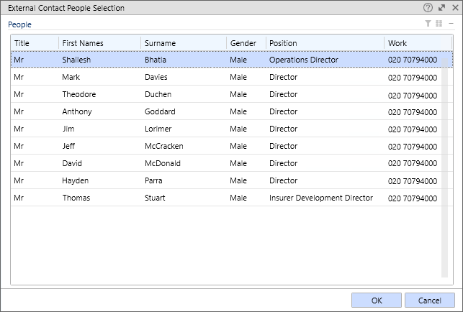
Add Contact
External Contact People Selection
External Contact People retrieved from FullCircl
User can select one to be Primary
Option to import more at a later stage if required

Slide 6
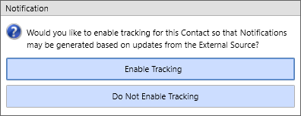
Track Contact
Tracking Notification
Once details are finalised and the new Company record is saved in Acturis the user is prompted for Tracking
Tracked Contacts will be tracked by FullCircl, notifications being picked up by Acturis and placed in the diary against that Contact
Acturis will store a list of Event Types, clients will be able to set up and manage automatic workflows based on the Event Type they are notified of

Slide 7
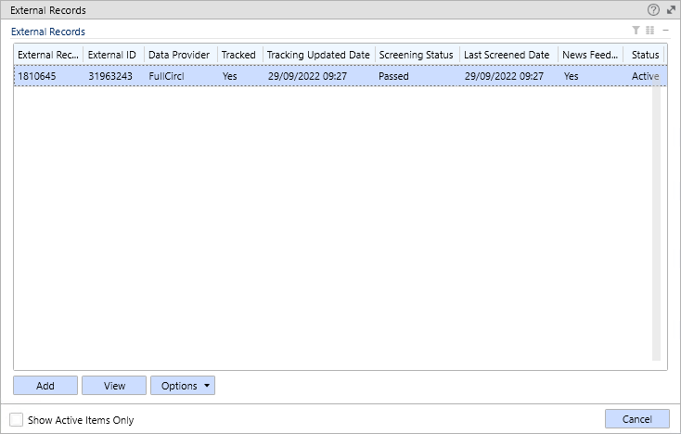
External Records
External Records Screen
This new screen (displayed within the Contact record) shows that a link to FullCircl exists
This screen supports:
Completing a new Company Search (for Contacts already stored but not yet enriched)
Repeating the Company Search in order to update fields with the latest data
Tracking and Un-Tracking the Company
Starting a Screening or viewing status of a Screening
Enable or Disable News Feed

Slide 8
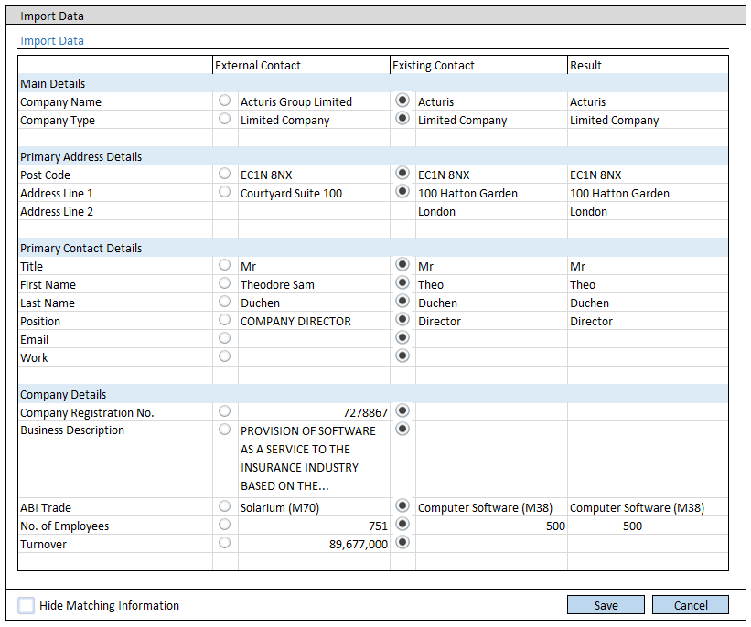
External Records
Update Contact
When updating a Company with enriched data a comparison screen will be displayed
This screen allows the user to choose to overwrite existing data as required
An equivalent screen will be available when updating individual people via the Director search

Slide 9
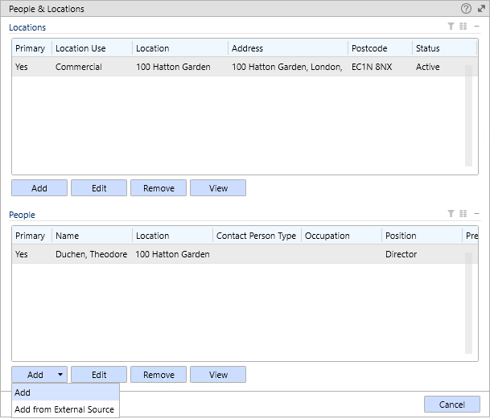
Add People
People & Locations Pop-Up
The existing People & Locations screen will be updated to include the option to “Add from External Source” provided that a FullCircl link is already in place

Slide 10
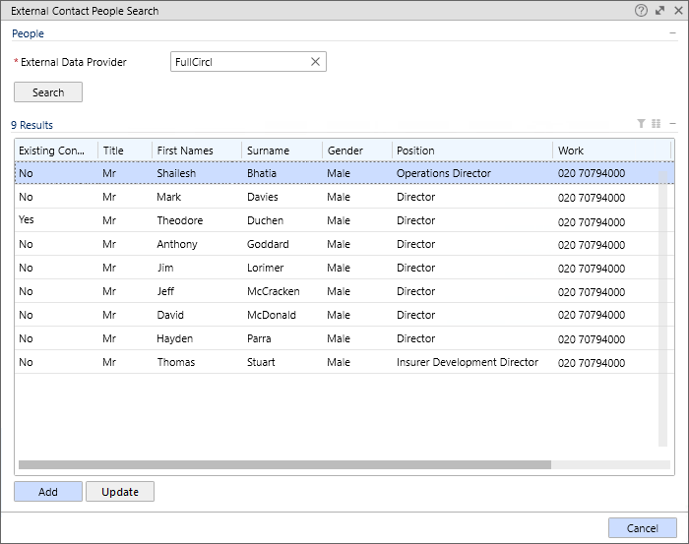
Add People
External Contact People Pop-Up
Pressing Add from External Source launches the External Contact People Search pop-up
Search on External Data Provider
Results grid matches the one shown when adding a Contact except with an “Existing Contact” column, identifying those already held in the system
Users can choose to import further people or Update those which are already held

Slide 11
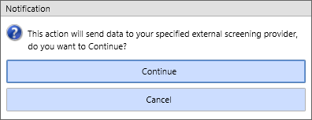
Run Screening
Run Screening Notification
Starting a screening process from the External Records Screen will send the request to FullCircl
Acturis will note when a screening is currently active
A user can “View Screening” to see a summary of flags (screen design in progress)

Slide 12
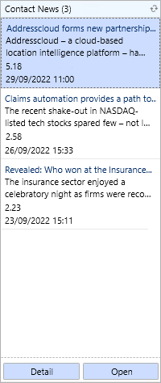
News Feed
Contact News Tool
A new tool will be added to the right-hand pane of the Acturis application
Assuming the News Feed is enabled (in the External Records Screen) then this will display collapsed with a count of news articles shown
Open will launch the relevant article in a web browser

